Slide 1
Documentation

Slide 2
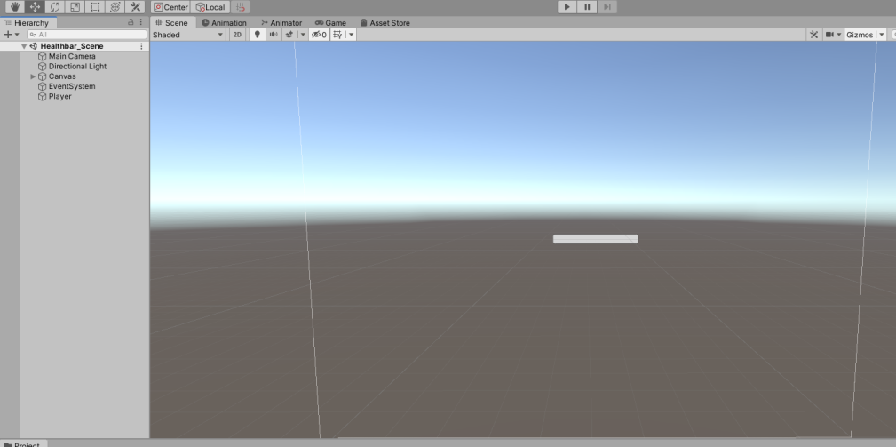
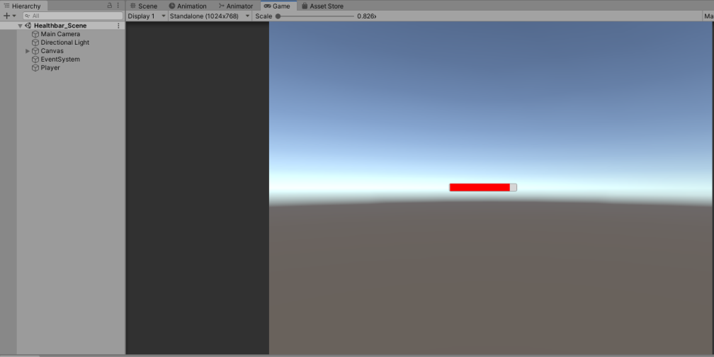
Scene
This is the test scene that I have created to test the mechanic. As you can see there is a bar in the middle which is the health bar and when I play the scene it will go red. I have also got a empty game object called “Player” that I am using to take away the health form the health bar.

Slide 3
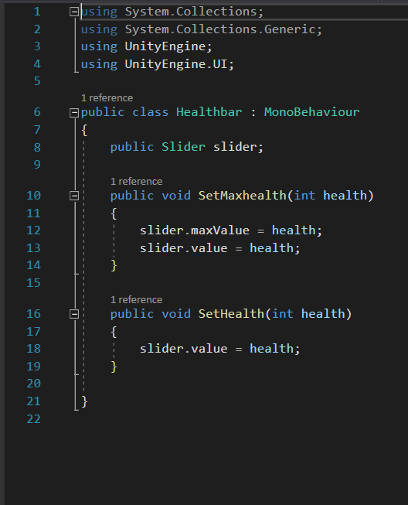
Health Bar Script
First off, I have a public reference to the slider bar of which I am using to show the current health value.
I then have a custom public void, its public so I can reference it in other scripts, I then have two values for the slider referencing the health.
After that I have another custom public void for the set health.

Slide 4
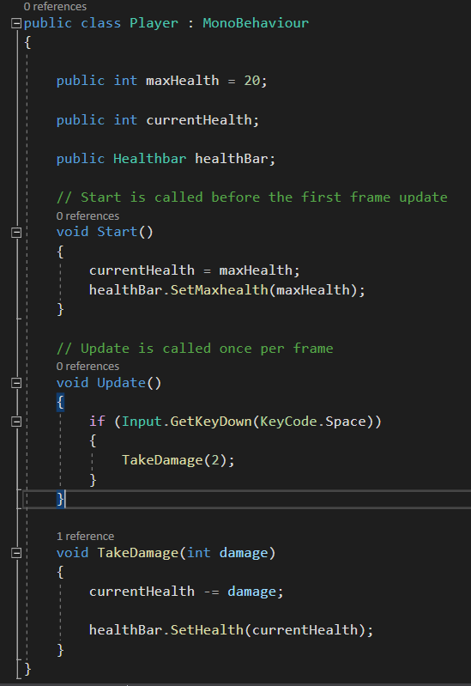
Player Script
Firstly I have again have a public reference to a game object in the scene “healthBar”
I then have two public int to set some values of which I used in the health bar script earlier
I then set some values in the start function for the health
I then add a command to enable me to manually take some damage with the spacebar on the keyboard. I do this with an “if” statement.
Lastly I add a void function to actually have damage take affect with an “int” that is referenced in the “if” statement

